Slide 1
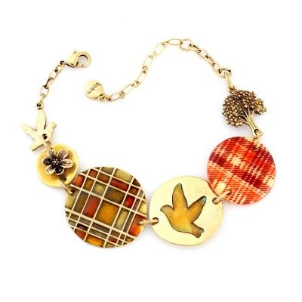
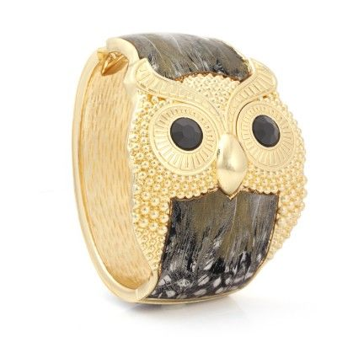
Jewelry Sales Data Analysis
Is it possible to predict the future sales?
Ding Li 2018.03
online store: costumejewelry1.com

Slide 2
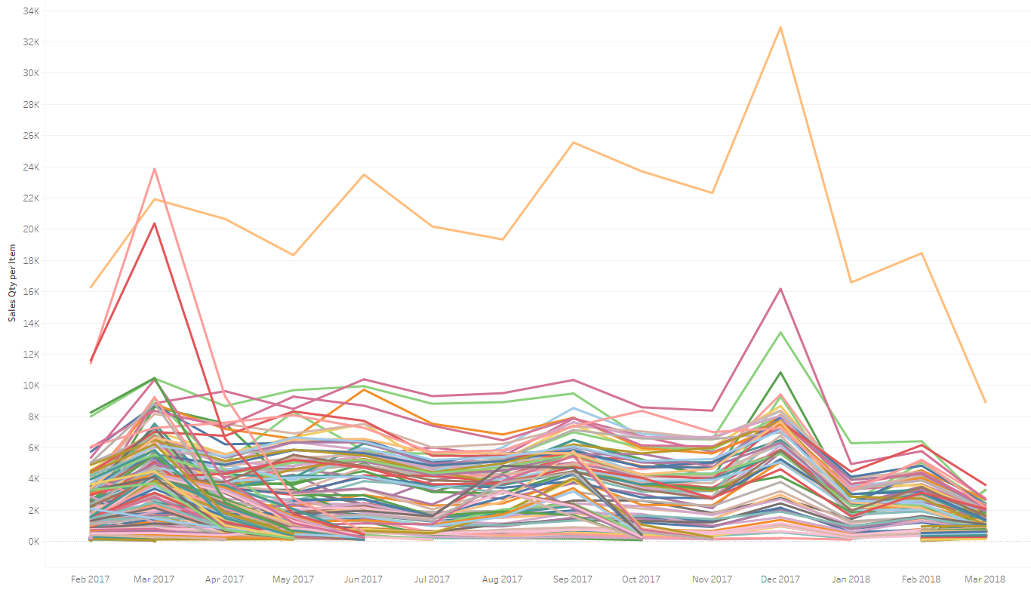
Sales treading of all items – Visualization in Tableau
Total Items: 355
Items with Sales in 13 Months: 65
Items interested: 24
March 2018 only has partial data.

Slide 3
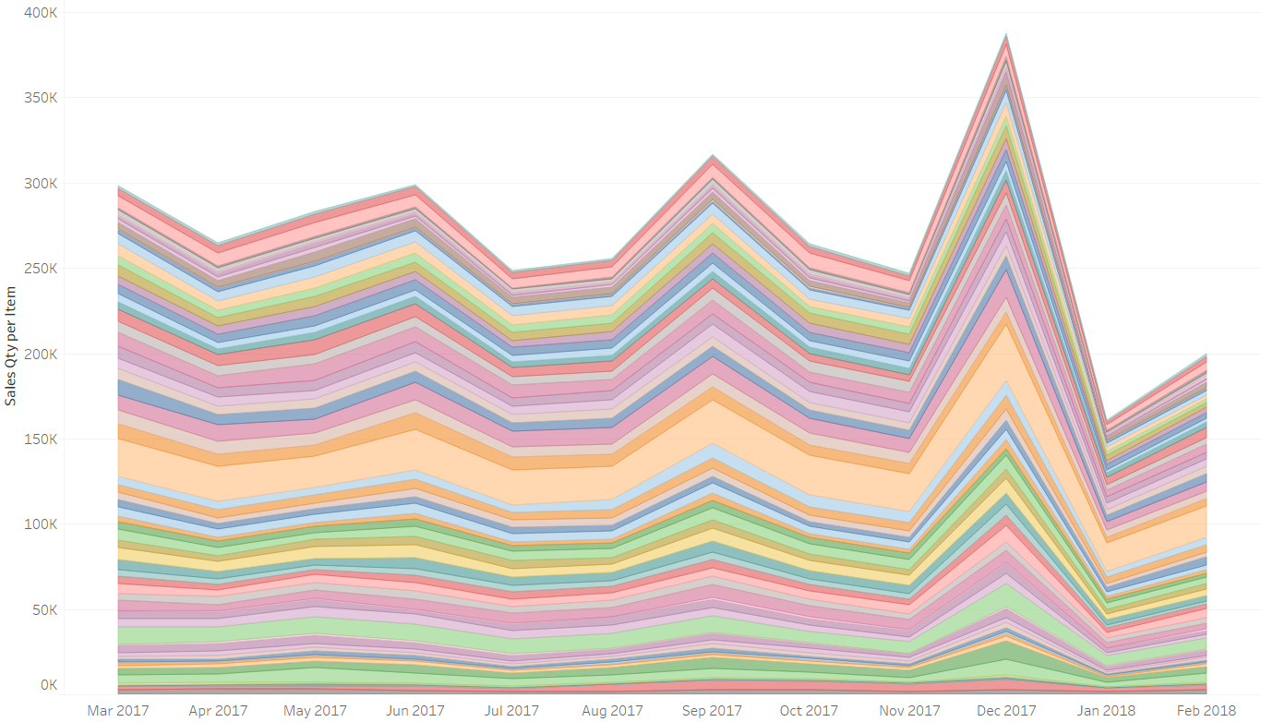
Sales treading of 65 items with Sales between mar 2017 –Feb 2018
Seasonality?
Need multiple years’ data
to study its influence.

Slide 4
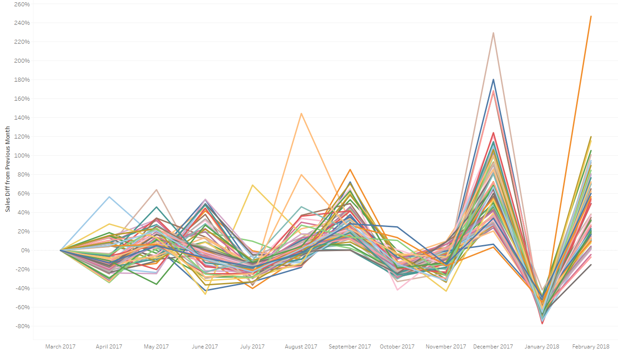
Sales Change from previous month – Any Pattern?
S$ales Monthly Diff \%=\frac{Current Month Sales −Last Month Sales}{Last Month Sales}$

Slide 5
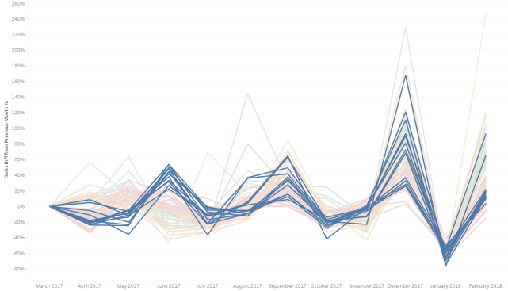
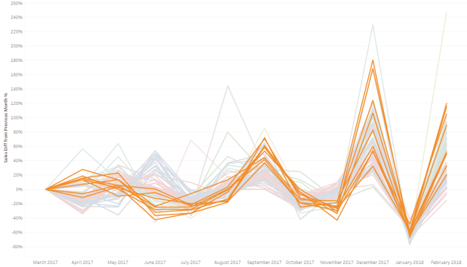
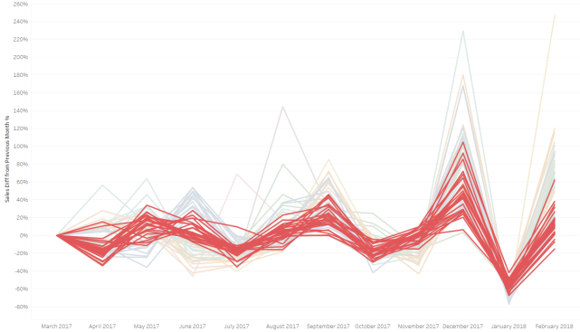
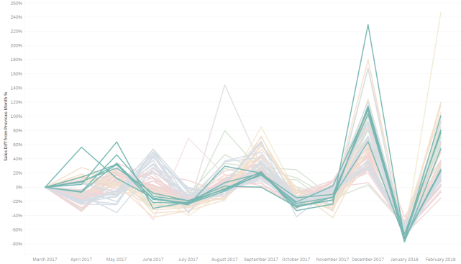
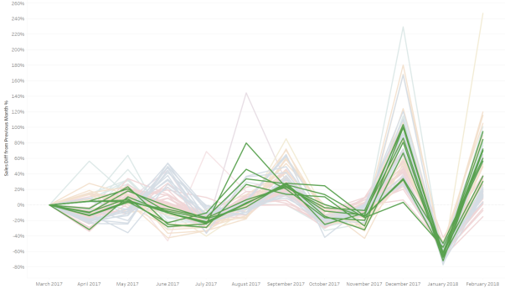
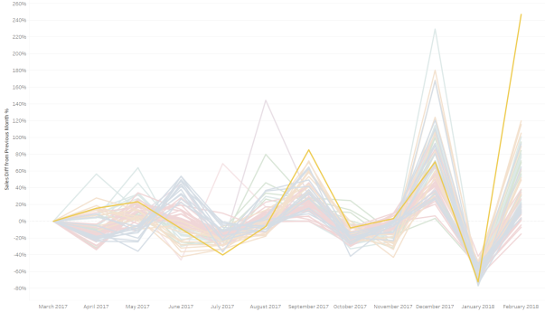
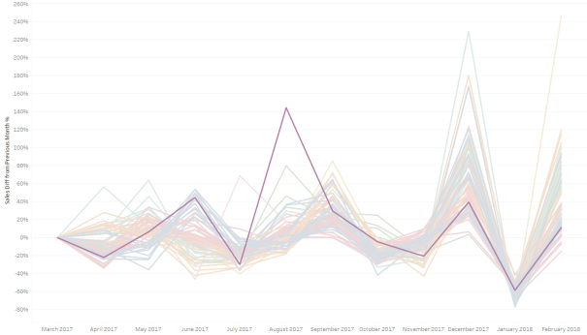
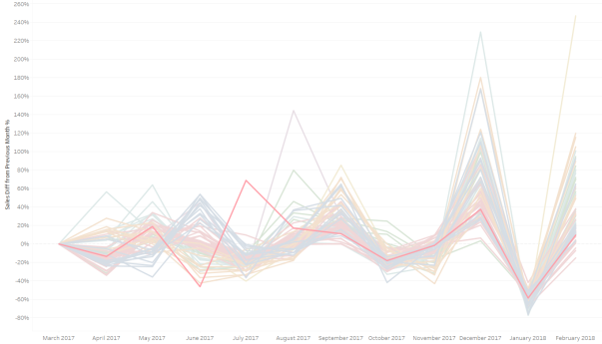

Agglomerative clustering – items of similar trending identified by python
Cluster 0: 12 items
Cluster 1: 9 items
Cluster 2: 25 items
Cluster 3: 7 items
Cluster 4: 9 items
Cluster 5: 1 item
Cluster 6: 1 item
Cluster 7: 1 item
$$sales diff \%=\frac{Current Month Sales −Last Month Sales}{Last Month Sales}$$

Slide 6
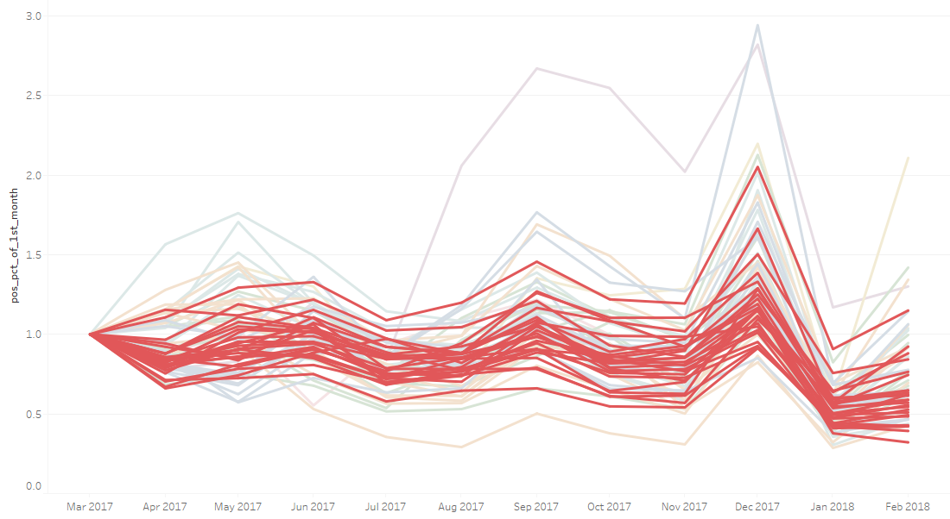

Sales relative to first mouth – applying the same Agglomerative clustering
Relative Sales $=\frac{Current Month Sales }{ First Month Sales}$

Slide 7
Conclusion
Seasonality
From
One Year Sales
Prediction
Need
Multi-Year Sales
Observed
Quantify
Long Term Trending

Slide 8
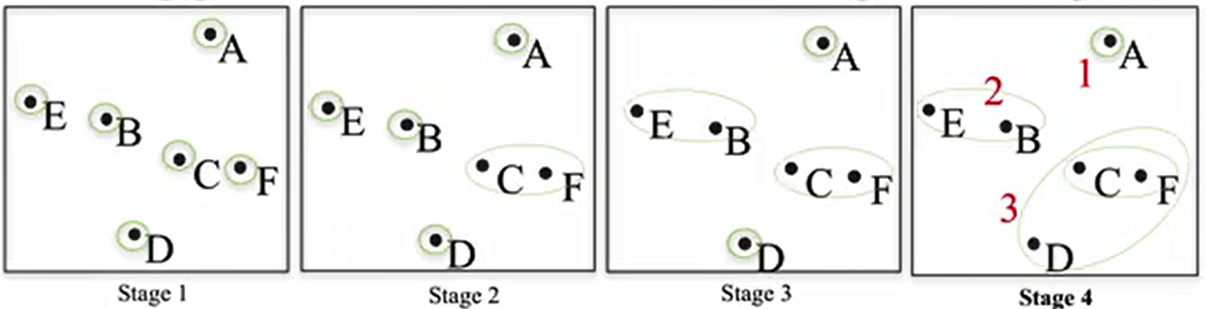
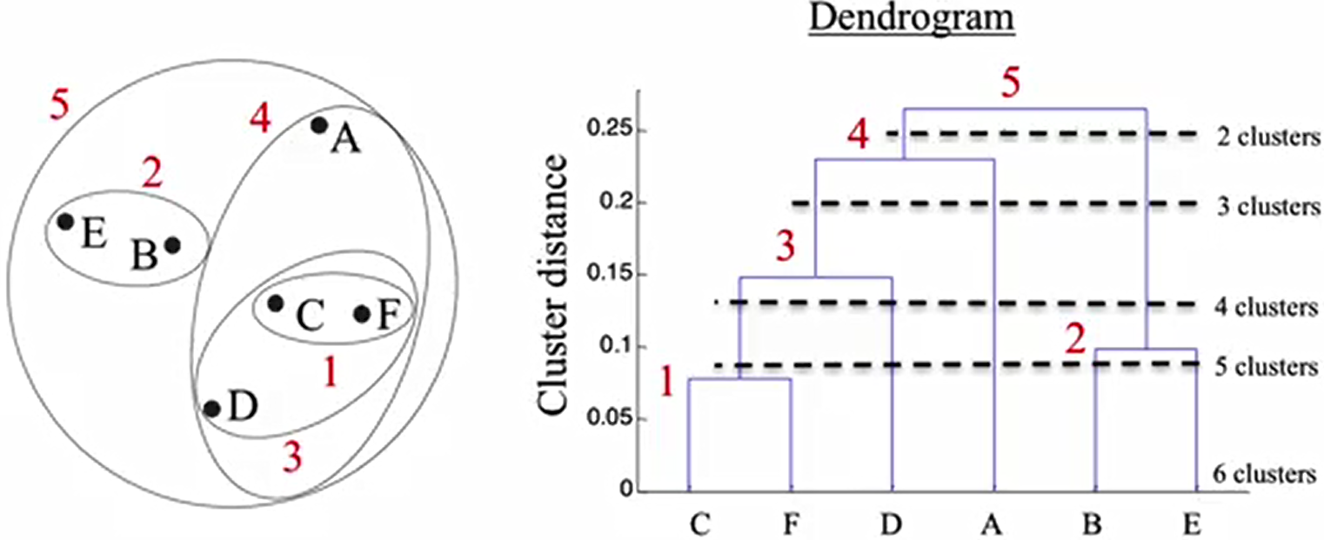
Appendix: Hierarchical Agglomerative clustering
Coding in Python:
from sklearn.cluster import AgglomerativeClustering
from sklearn.preprocessing import MinMaxScaler
#normalize the input
scaler = MinMaxScaler()
X_scaled = scaler.fit_transform(X)
#calculate clustering and get label
agglomerative = AgglomerativeClustering(n_clusters=8)
.fit(X_scaled)
label=agglomerative.labels_.tolist()
http://scikit-learn.org/stable/modules/generated/sklearn.cluster.AgglomerativeClustering.html

Slide 9
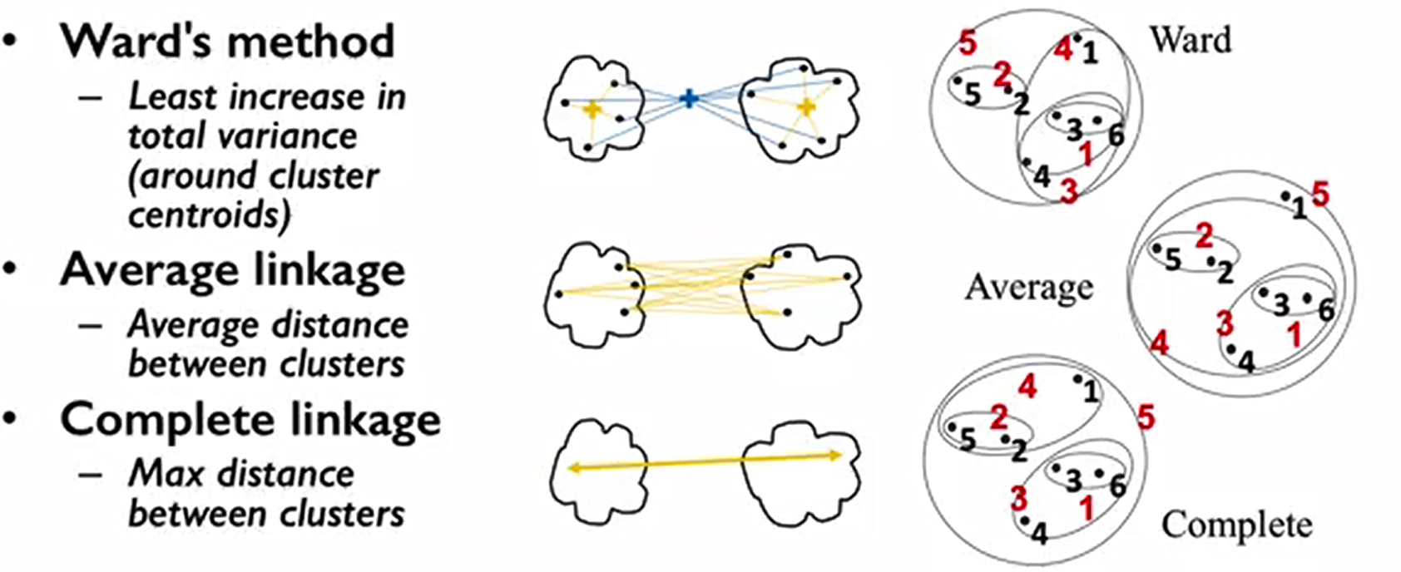
Appendix: linkage Criteria for Agglomerative clustering
Kevyn Collins-Thompson, Coursera Class: Applied Machine Learning in Python,
https://www.coursera.org/learn/python-machine-learning/lecture/Xs8IM/clustering, downloaded on 12/20/2017

Slide 10
Appendix: Agglomerative clustering items
Cluster | Item | Item Desc | Color
0 | ADX6407030 | 7 ROW CRY STRETCH | CRYSTA
 | ADX6800249 | GOLD ARROW | GOLD
 | ADX6800311 | F/B RG CRY FLWR/STAR | CRYST
 | ADX6800381 | F/B PRL RG FIREBALL | PEARL
 | ADX6802090 | 9-ON ANCHOR/BOW | CRYST
 | ADX6802091 | 6-ON CREAM FLOWER | SLCRPR
 | ADX6802094 | 6PC GL CRY OPEN RING | GLCC
 | ADX6802175 | 6-ON MLT FAUX STONE | MULTI
 | ADX6802179 | 6-ON SLBK SET-F/B | MULTI
 | ADX6802186 | 6PC MIX METAL RINGS | GLSLRG
 | ADX6802187 | 6PC SL/TQ RING SET | TURQ
 | ADX6812031 | SL CRY NO OTHER LIKE | SLCC
1 | ADX6407046 | DECO V NECK&EAR SE | CRYSTA
 | ADX6407051 | "S" NECK & EAR SET | CRYST
 | ADX6407688 | CRYSTAL STONE STRETC | CRYSTA
 | ADX6802213 | 6-ON SMALL HOOP | GL
 | ADX6811004 | STR SOC CASTED BRAC | SLCC
 | ADX6812008 | SOCIAL SWIRL Y NE SE | CRYST
 | ADX6812010 | SOCIAL 5 LOOP NE SET | SLCC
 | ADX6812037 | SL CRY 3LAYER SOCIAL | SLCC
 | ADX6813002 | SL CRYSTAL COMB | SLCC
Cluster | Item | Item Desc | Color
2 | ADX6800007 | LARGE FIREBALL STUD | SLCC
 | ADX6800009 | PAVE SQUARE EARS | SLCC
 | ADX6800059 | GL CRY RND STUD | GLCC
 | ADX6800060 | GL BLACK CRY RNDSTUD | GLJT
 | ADX6800094 | GL NAVETTE CRYSTAL | GLCC
 | ADX6800095 | GL PAVE BEZEL CRY | GLCC
 | ADX6800108 | GL NAVETTE NEUTRAL | GLNECC
 | ADX6800115 | GL OPAQ PEACH | GLPE
 | ADX6800129 | BLACK NAVETTE | BLACK
 | ADX6800160 | GL CRY CENTER STONE | CRYST
 | ADX6800163 | GL BLACK FLOWER | GLBK
 | ADX6800164 | GL BLK CENTER STONE | BLACK
 | ADX6800175 | SL LINEAR FEATHER | SL
 | ADX6800176 | GL VITRAL STUD | GLGR
 | ADX6800308 | F/B BK CRY FRINGE | BLACK
 | ADX6800313 | DUO WHITE PEARL | PEARL
 | ADX6800384 | F/B GOLD FRINGE | GLCC
 | ADX6802093 | 6PC SIL CRY RING SET | CRYST
 | ADX6802096 | 3PC GL CRY RING SET | CRYST
 | ADX6802176 | 6-ON GLTQ SET -F/B | TURQ
 | ADX6802178 | 6-ON GOLD SET -F/B | MULTI
 | ADX6802188 | BK CIRCLE W/TASSLE | BK
 | ADX6802206 | 6-ON PEARL F/B FAN | PEARL
 | ADX6802207 | 6-ON CRYSTUD PRL F/B | MULTI
 | ADX6807039 | SILVR SNAKE 18" NECK | SL
Cluster | Item | Item Desc | Color
3 | ADX6407074 | SILVR FIRBALL N/E | CRYSTA
 | ADX6802267 | SILVER TURQ BRACELET | TURQ
 | ADX6811001 | GL/CRY BRACE EAR SET | GLCC
 | ADX6812012 | GOLD PEARL NE SET | PEARL
 | ADX6812028 | HEM ROSE/CRY STONE | HMPCCC
 | ADX6812032 | SL YOU ARE SPECIAL | SLCC
 | ADX6812049 | GL CRY FLOWER V | GLCC
4 | ADX6407003 | 42" PEARL NECK | NONE
 | ADX6407004 | 3PC PEARL BRACELET | NONE
 | ADX6407008 | PEARL 8MM NECK | PEARL
 | ADX6407009 | PEARL TWIST NECK | NONE
 | ADX6407035 | 3PC STONE STRETCH | CRYSTA
 | ADX6407087 | SILVER PEARL NE SET | CRYSTA
 | ADX6800089 | GOLD TXT DISK KITE | GL
 | ADX6812013 | JET PEARL NE SET | SLJT
 | ADX6812014 | SNGLE PEARL DROP SET | SLCR
5 | ADX6812050 | BKGL CROSS CHOKER | GLBK
6 | ADX6812052 | PEARL WEB CHOKER SET | PEARL
7 | ADX6802231 | 4PC GL/PRL RING SET | MULTI

